Slide 1
JUPYTER NOTEBOOK
Sourav Karmakar
souravkarmakar29@gmail.com

Slide 2
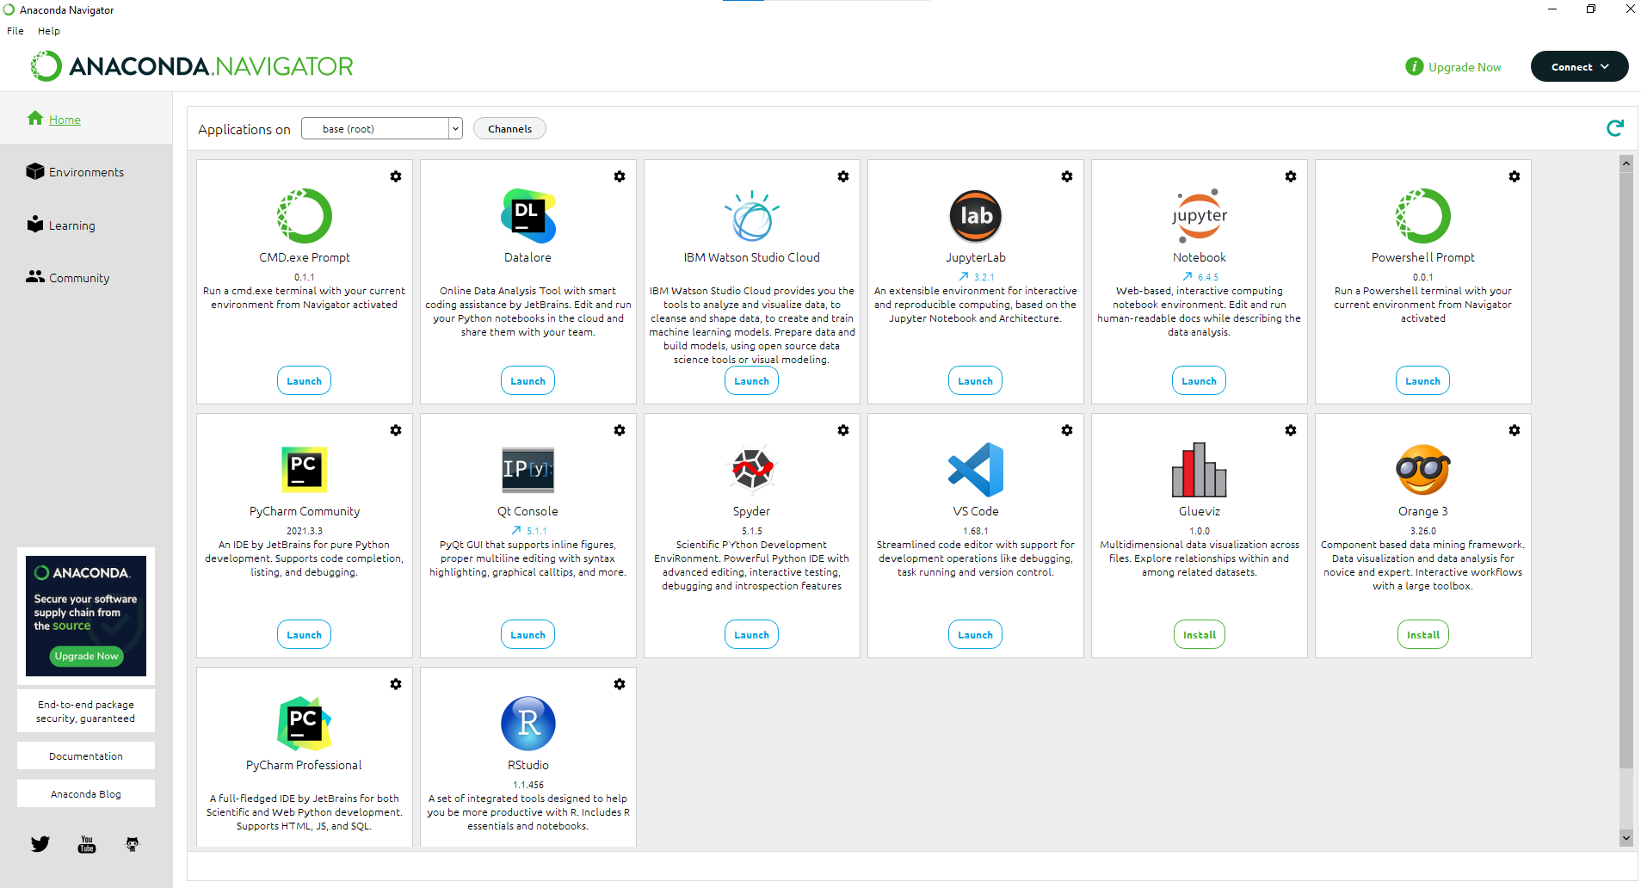
Anaconda Navigator
When you open Anaconda Navigator you will see something like following:
Click on Launch icon of Jupyter Notebook

Slide 3
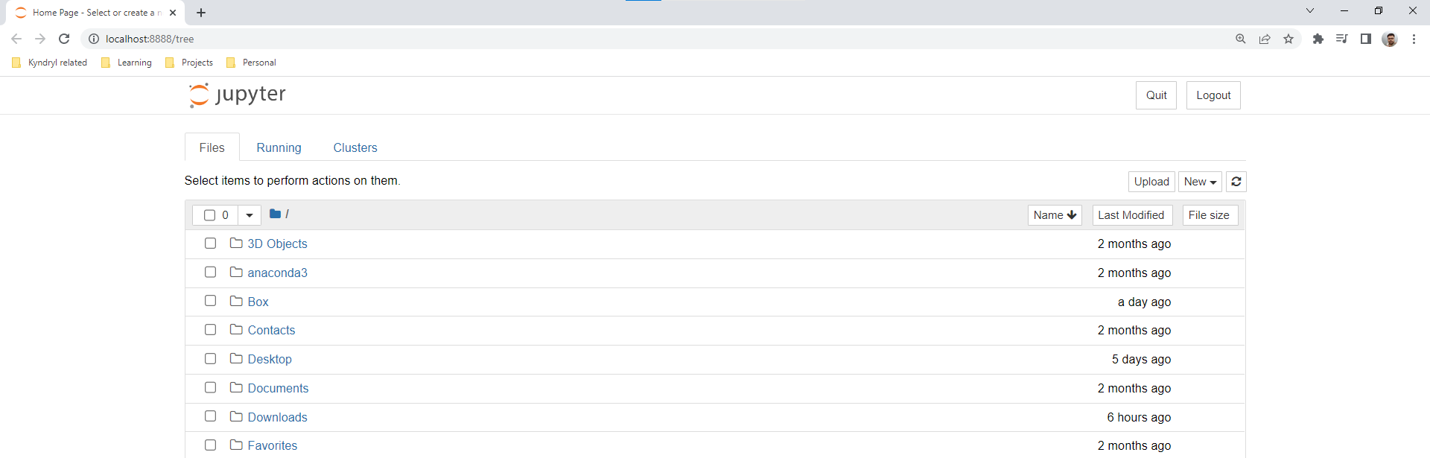
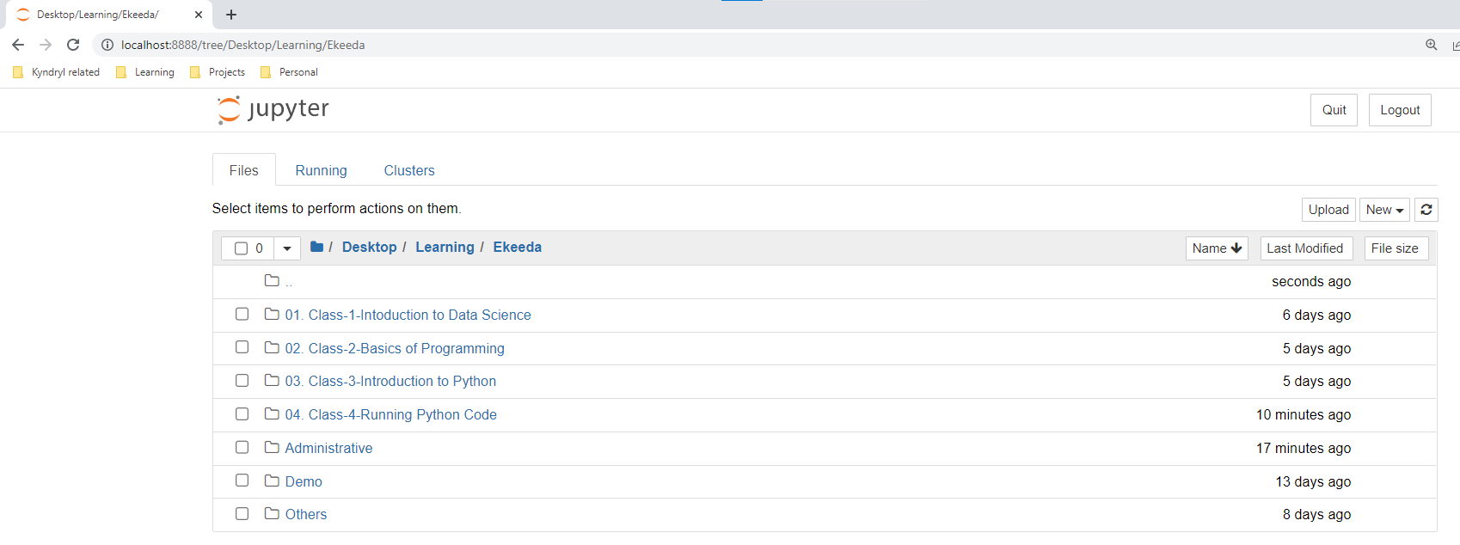
Jupyter Notebook
It runs on localhost, hence you don’t need internet connection to run it.
File Browser shown in Jupyter Notebook. You can browse to any directory you want.
Note the change in URL path and File path when you browse to a any directory.

Slide 4
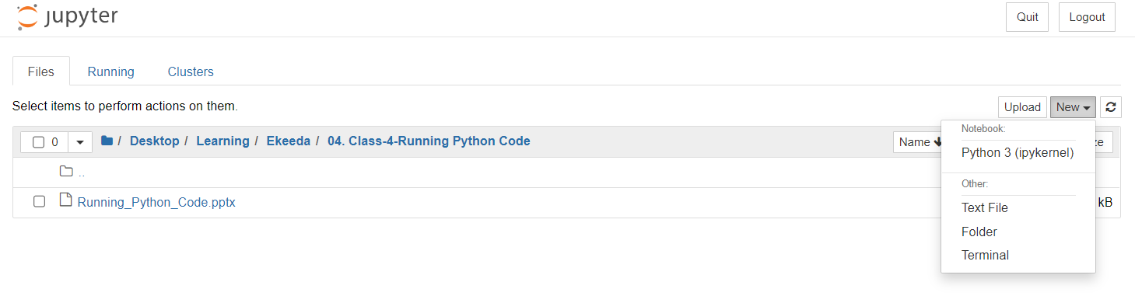
Jupyter Notebook
Jupyter Notebook is a browser based Interactive Computing Platform preferably used to run Interactive Python Notebook (.ipynb) files.
From the drop down you can:
Create a Python3 notebook (.ipynb file)
Create a Text File
Create a folder or directory under the current directory
Open a terminal
We will mostly use it to run .ipynb files

Slide 5
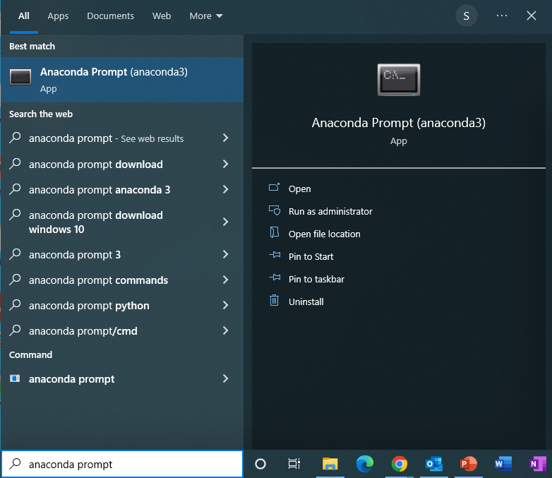
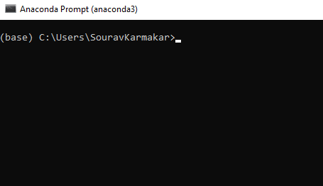
Open Jupyter Notebook from terminal
Step-1: Search “anaconda prompt” in the windows search box and open it
Step-2: You will see a black window as shown beside with title “Anaconda Prompt (anaconda3)”
Note that you should see (base) in your command prompt

Slide 6
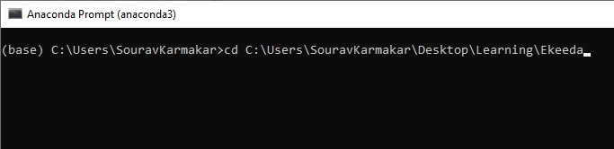
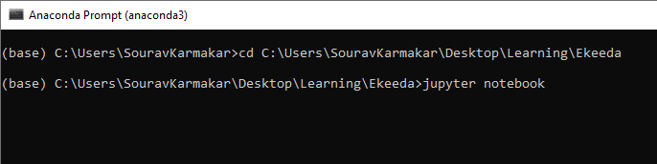
Open Jupyter Notebook from Terminal
Step-3: Write “cd <path name of your desired folder location>” as shown beside and hit enter.
Step-4: After you enter your desired path location you can type “jupyter notebook” and hit enter.
Now a browser window will open with Jupyter as shown previously

Slide 7
Thank You

